Slide 1
AC/DC – not the Rock Band
Alternating Current (AC).
The power that comes from a power plant
The direction of the current reverses, or alternates, 60 times per second (in the U.S.) or 50 times per second (in Europe, for example).
The power that is available at a wall socket in the United States is 120-volt, 60-cycle AC power.
The big advantage that AC provides for the power grid is the fact that
  it is relatively easy to change the voltage of the power, using a device called a transformer.
  By using very high voltages for transmitting power long distances, power companies can save a lot of money
http://www.launc.tased.edu.au/online/sciences/PhysSci/done/electric/acdc/ACDC.htm

Slide 2
AC – Alternating Current
Alternating Current (AC).
Here's some material on the questions you asked: http://users.pandora.be/worldstandards/electricity.htm http://www.school-for-champions.com/science/ac_world_volt_freq.htm http://www.absoluteastronomy.com/encyclopedia/m/ma/mains_electricity.htm
These provide a good overview of why different voltages are used in different countries.

Slide 3
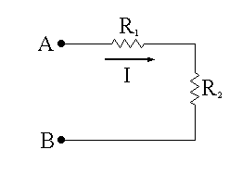
DC Circuit
In a DC (Direct Current) circuit,
produced by batteries, fuel cells and solar cells
the direction of current flow at any point in the circuit that is not a node does not change with time.
The magnitude of the current may change in a DC circuit, but the direction of the current flow may not change

Slide 4
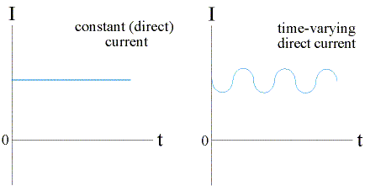
DC Circuit
positive current flow through resistor R₁ from left to right
negative current corresponds to flow from right to left
In a dc circuit, if we see that the current through R₁ is positive at some time, it will still be positive at any later time.

Slide 5
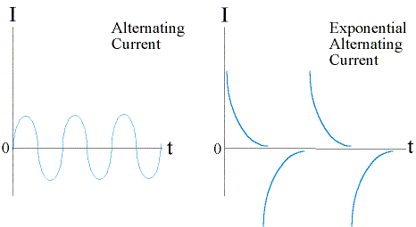
AC Circuit
In an AC (Alternating Current) circuit,
current direction (as well as its magnitude) changes with time. The current alternates flowing first one way, then the other way, then back again

Slide 6
Ohms’ Law
Three most basic units in electricity are
Voltage (V): measured in volts
Current (I): measured in amps
Resistance (R): measured in ohms.
Using a water analogy:
“The voltage is equivalent to the water pressure, the current is equivalent to the flow rate, and the resistance is like the pipe size.”

Slide 7
Ohms’ Law
Ohm's Law deals with the relationship between voltage and current in an ideal conductor.
Ohm's Law is given by: V = I R
This relationship states that:
The potential difference (voltage) across an ideal conductor is proportional to the current through it.
Or, the current is equal to the voltage divided by the resistance.
I = V/R

Slide 8
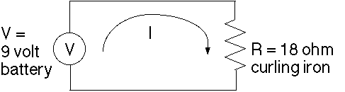
Ohms’ Law
Example
A 9 volt battery supplies power to a cordless curling iron with a resistance of 18 ohms. How much current is flowing through the curling iron?

Slide 9
Ohms’ Law
Example
A 9 volt battery supplies power to a cordless curling iron with a resistance of 18 ohms. How much current is flowing through the curling iron?
A 110 volt wall outlet supplies power to a strobe light with a resistance of 2200 ohms. How much current is flowing through the strobe light?

Slide 10
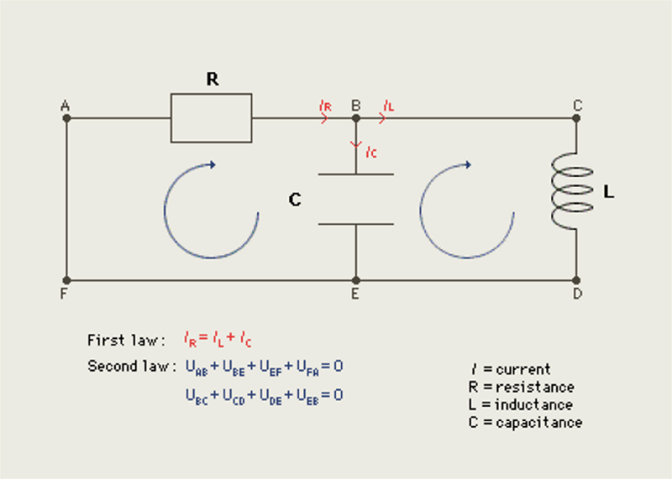
Kirchoff’s Rules

Slide 11
Kirchoff’s Rules
Govern the flow of current and voltage through an electric circuit.
Junction Rule (Current Rule):
  The sum of currents going into a junction (where the circuit splits) must be equal to the sum of currents going out of the junction.
Loop Rule (Voltage Rule):
  The sum of voltages over a closed circuit must be zero.
Examples

Slide 12
RC Time Constant
Capacitors
The role of the capacitor in a circuit is a little more complicated than that of the resistor
A capacitor is a device which allows us to store charge
The "capacitance" of a capacitor is stated in terms of the amount of charge (Q) stored at a given voltage drop (across the capacitor):
C = Q / V.
The unit of capacitance is the "Farad", which is equal to a C/V.
It is a very large unit; typical capacitances are measured in microfarads or picofarads.

Slide 13
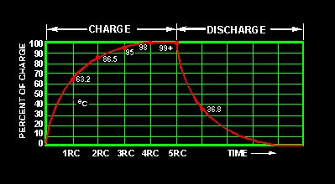
RC Time Constant
Time required to charge a capacitor to 63 percent (actually 63.2 percent) of full charge or to discharge it to 37 percent (actually 36.8 percent) of its initial voltage is known as the TIME CONSTANT (TC) of the circuit.

Slide 14
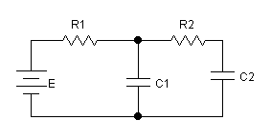
RC Time Constant
A Simple RC Circuit (example)
  http://othello.mech.northwestern.edu/ea3/book/elec5/RC.htm
Three time periods in the behavior of any RC circuit:
  the initial period, when the voltage source is first switched on.
  the transient period, while the capacitors are being charged up.
  the steady-state period, after the capacitors have been fully charged up.

Slide 15
RC Time Constant
RC circuits have a time constant associated with them which is R*C and that such circuits could effectively be used as timers.
We also see that the capacitor allows a current through only until it has reached an equilibrium voltage, at which point the current stops.

Slide 16
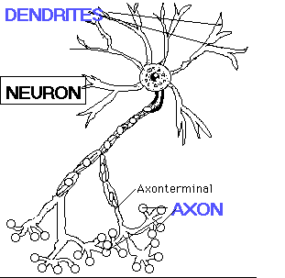
RC Time Constant Examples
Camera Flash
http://www.eas.asu.edu/~holbert/ece201/cameraflash.html
The modeling of a human neuron system

Slide 17
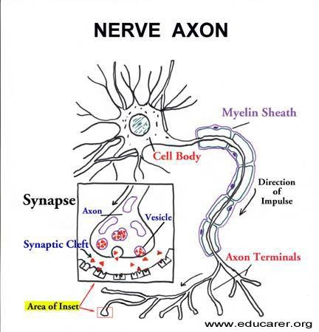
RC Time Constant Examples
The modeling of an Axon
A neuron: a cell with protrusions, very long compared to the cell body.
Information is integrated within the cell body, which, in turn, sends out "action potentials" (electrochemical signals).
signals travel along the axon to the end of the axon (dendrites) at which point a synapse may occur.
One can consider axons to be like electrical wires.

Slide 18
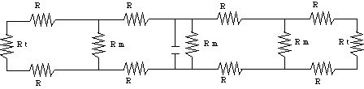
RC Time Constant Examples
The modeling of an Axon
  A neuron: a cell with protrusions, one of which is very long compared to the cell body.
  The small protrusions are called "dendrites", and on their ends are the "synapses" which receive chemical signals from other neurons.
  The long protrusion is called the "axon"; at its far end are nerve endings which can release chemical signals to be received on the synapses of neurons in its neighborhood.
  We can model an axon by the following electrical circuit fragment:

Slide 19
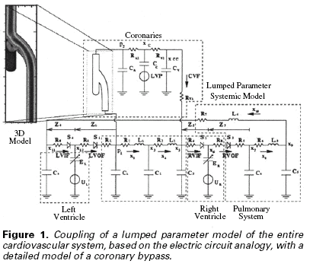
RC Time Constant Examples
The modeling of a human cardiovascular system
  “fluid” ⬄ “current”; “fluid pressure drop” ⬄ "voltage drop"
  “Poiseuille's Law” corresponds to "Ohm's Law"

